Slide 1
Linear Regression
EPI 809/Spring 2008

Slide 2
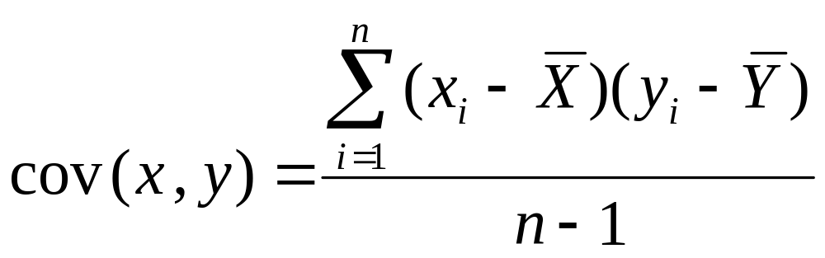
Recall: Covariance

Slide 3
Interpreting Covariance
cov(X,Y) > 0 X and Y are positively correlated
cov(X,Y) < 0 X and Y are inversely correlated
cov(X,Y) = 0 X and Y are independent

Slide 4
Correlation coefficient
The Pearson’s correlation coefficient.
Spearman’s correlation coefficient.
Kendall’s correlation coefficient.

Slide 5
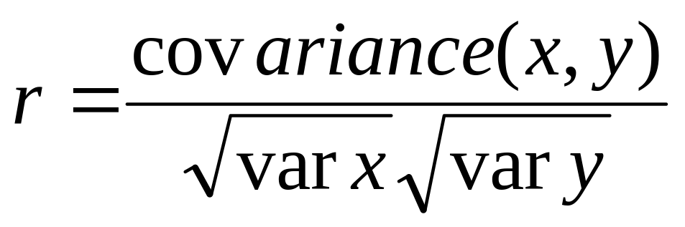
Pearson’s Correlation coefficient
It is calculated as the covariance of the two variables divided by the product of the standard deviation of each data sample.
Pearson’s Correlation Coefficient is standardized covariance (unitless)
Correlations are very sensitive to outliers;
corr, _ = pearsonr(data1, data2)

Slide 6
Correlation
Measures the relative strength of the linear relationship between two variables
Unit-less
Ranges between –1 and 1
The closer to –1, the stronger the negative linear relationship
The closer to 1, the stronger the positive linear relationship
The closer to 0, the weaker any positive linear relationship

Slide 7
Scatter Plots of Data with Various Correlation Coefficients
Y
Y
Y
X
X
X
r = -1
r = -.6
r = 0
Y
Y
Y
X
X
X
r = +1
r = +.3
r = 0
Slide from: Statistics for Managers Using Microsoft® Excel 4th Edition, 2004 Prentice-Hall

Slide 8
Linear Correlation
Linear relationships
Curvilinear relationships
Y
Y
X
X
Y
Y
X
X
Slide from: Statistics for Managers Using Microsoft® Excel 4th Edition, 2004 Prentice-Hall

Slide 9
Linear Correlation
Strong relationships
Weak relationships
Y
Y
X
X
Y
Y
X
X
Slide from: Statistics for Managers Using Microsoft® Excel 4th Edition, 2004 Prentice-Hall

Slide 10
Linear Correlation
No relationship
Y
X
Y
X
Slide from: Statistics for Managers Using Microsoft® Excel 4th Edition, 2004 Prentice-Hall

Slide 11
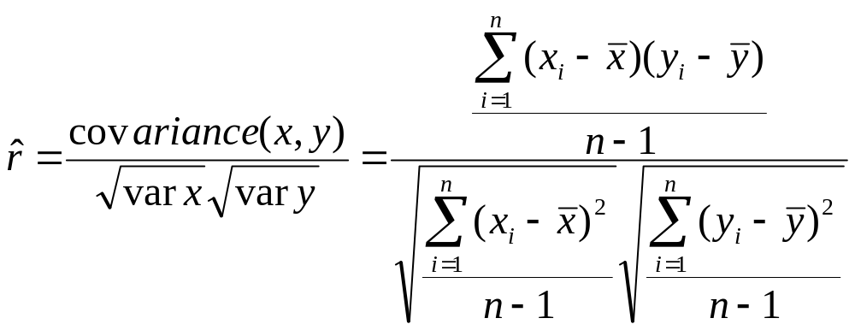
Calculating by hand…

Slide 12
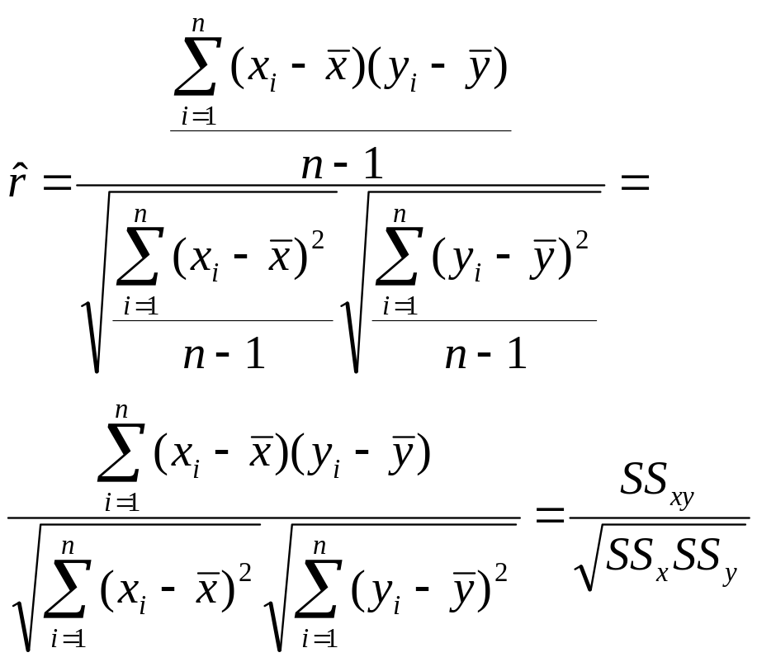
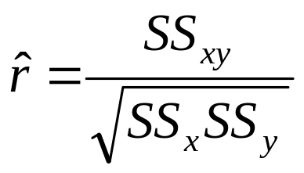
Simpler calculation formula…
Numerator of covariance
Numerators of variance

Slide 13
Spearman’s Correlation
If you are unsure of the distribution and possible relationships between two variables, Spearman correlation coefficient is a good tool to use.
These statistics are calculated from the relative rank of values on each sample.
Spearman's correlation coefficient = covariance(rank(X), rank(Y)) / (stdv(rank(X)) * stdv(rank(Y)))
corr, _ = spearmanr(data1, data2)

Slide 14
Kendall’s Correlation
It is also a rank correlation coefficient, measuring the association between two measured quantities.
It is harder to calculate than Spearman’s, but it has been argued that confidence intervals for Spearman’s are less reliable and less interpretable than confidence intervals for Kendall’s parameters.
corr, p = kendalltau(data1, data2)

Slide 15
Linear Regression
EPI 809/Spring 2008
Notes:
26

Slide 16
What is a Math/Stats Model?
Model: Representation of Some Phenomenon
Model often Describe Relationship between Variables
Types
    Deterministic Models (no randomness)
    Probabilistic Models (with randomness)
EPI 809/Spring 2008
Notes:
.

Slide 17
Deterministic Models
Hypothesize Exact Relationships
Suitable When Prediction Error is Negligible
Example: Body mass index (BMI) is measure of body fat based
  Metric Formula: BMI = Weight in Kilograms
  (Height in Meters)²
EPI 809/Spring 2008

Slide 18
Probabilistic Models
Hypothesize 2 Components
    Deterministic
    Random Error
Example: Systolic blood pressure of newborns Is 6 Times the Age in days + Random Error
    SBP = 6 * age(d) + ε
    Random Error May Be Due to Factors Other Than age in days (e.g. Birthweight)
EPI 809/Spring 2008

Slide 19
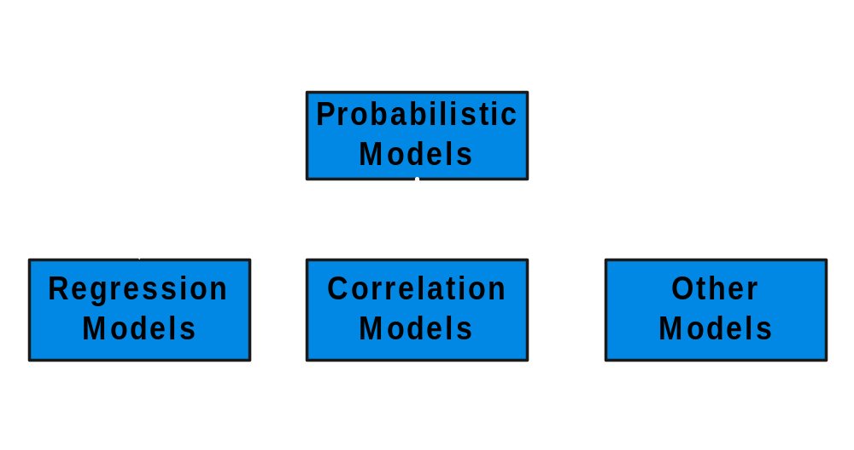
Types of
Probabilistic Models
EPI 809/Spring 2008
Notes:
7

Slide 20
Regression Models
EPI 809/Spring 2008
Notes:
13

Slide 21
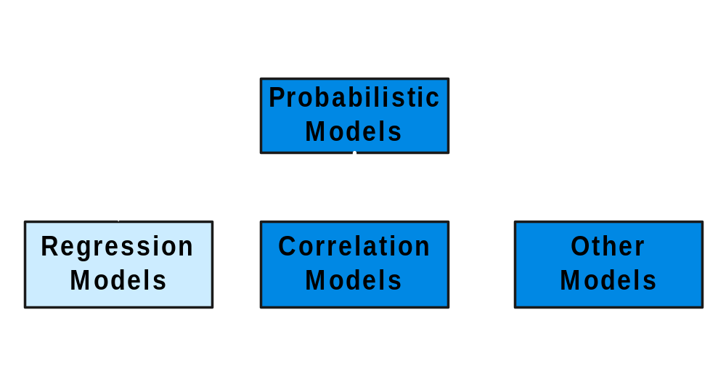
Types of
Probabilistic Models
EPI 809/Spring 2008
Notes:
7

Slide 22
Regression Models
Relationship between one dependent variable and explanatory variable(s)
Use equation to set up relationship
    Numerical Dependent (Response) Variable
    1 or More Numerical or Categorical Independent (Explanatory) Variables
Used Mainly for Prediction & Estimation
EPI 809/Spring 2008

Slide 23
Regression Modeling Steps
1. Hypothesize Deterministic Component
    Estimate Unknown Parameters
2. Specify Probability Distribution of Random Error Term
    Estimate Standard Deviation of Error
3. Evaluate the fitted Model
4. Use Model for Prediction & Estimation
EPI 809/Spring 2008

Slide 24
Model Specification
EPI 809/Spring 2008
Notes:
13

Slide 25
Specifying the deterministic component
1. Define the dependent variable and independent variable
2. Hypothesize Nature of Relationship
  Expected Effects (i.e., Coefficients’ Signs)
  Functional Form (Linear or Non-Linear)
  Interactions
EPI 809/Spring 2008

Slide 26
Types of
Regression Models
EPI 809/Spring 2008
Notes:
18
This teleology is based on the number of explanatory variables & nature of relationship between X & Y.

Slide 27
Types of
Regression Models
Regression
Models
EPI 809/Spring 2008
Notes:
19
This teleology is based on the number of explanatory variables & nature of relationship between X & Y.

Slide 28
Types of
Regression Models
1 Explanatory
Regression
Variable
Models
Simple
EPI 809/Spring 2008
Notes:
20
This teleology is based on the number of explanatory variables & nature of relationship between X & Y.

Slide 29
Types of
Regression Models
1 Explanatory
Regression
2+ Explanatory
Variable
Models
Variables
Simple
Multiple
EPI 809/Spring 2008
Notes:
21
This teleology is based on the number of explanatory variables & nature of relationship between X & Y.

Slide 30
Types of
Regression Models
1 Explanatory
Regression
2+ Explanatory
Variable
Models
Variables
Simple
Multiple
Linear
EPI 809/Spring 2008
Notes:
22
This teleology is based on the number of explanatory variables & nature of relationship between X & Y.

Slide 31
Types of
Regression Models
1 Explanatory
Regression
2+ Explanatory
Variable
Models
Variables
Simple
Multiple
Non-
Linear
Linear
EPI 809/Spring 2008
Notes:
23
This teleology is based on the number of explanatory variables & nature of relationship between X & Y.

Slide 32
Types of
Regression Models
1 Explanatory
Regression
2+ Explanatory
Variable
Models
Variables
Simple
Multiple
Non-
Linear
Linear
Linear
EPI 809/Spring 2008
Notes:
24
This teleology is based on the number of explanatory variables & nature of relationship between X & Y.

Slide 33
Types of
Regression Models
1 Explanatory
Regression
2+ Explanatory
Variable
Models
Variables
Simple
Multiple
Non-
Non-
Linear
Linear
Linear
Linear
EPI 809/Spring 2008
Notes:
24
This teleology is based on the number of explanatory variables & nature of relationship between X & Y.

Slide 34
Linear Regression Model
EPI 809/Spring 2008
Notes:
26

Slide 35
Assumptions (or the fine print)
Linear regression assumes that…
  1. The relationship between X and Y is linear
  2. Y is distributed normally at each value of X
  3. The variance of Y at every value of X is the same (homogeneity of variances)
  4. The observations are independent

Slide 36
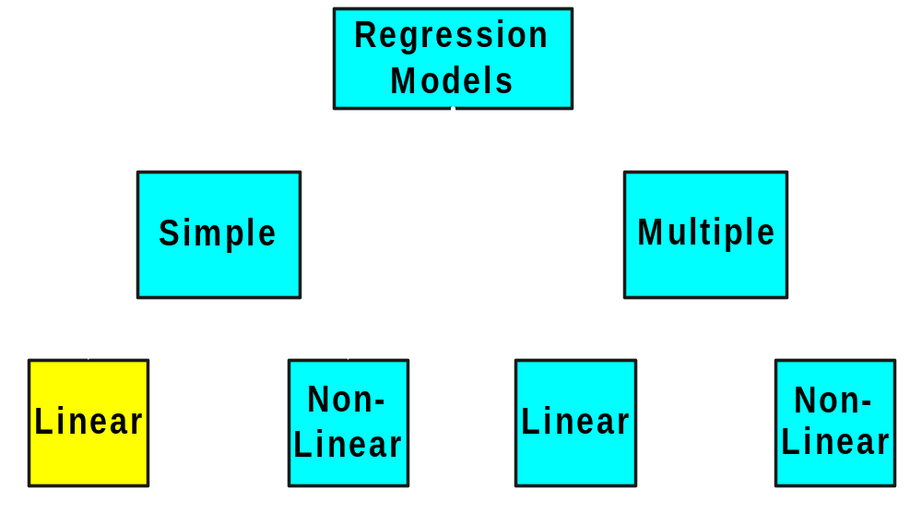
Types of
Regression Models
EPI 809/Spring 2008
Notes:
27
This teleology is based on the number of explanatory variables & nature of relationship between X & Y.

Slide 37


Linear Equations
EPI 809/Spring 2008
© 1984-1994 T/Maker Co.
Notes:
28

Slide 38
Linear Regression Model
Relationship Between Variables Is a Linear Function
Population
Y-Intercept
Population Slope
Random Error
Y
=
β
+
β
X
+
ε
i
0
1
i
i
Dependent (Response) Variable
(e.g., score)
Independent (Explanatory) Variable
(e.g., attendance, mid marks)

Slide 39
Estimating Parameters:
Least Squares Method
EPI 809/Spring 2008
Notes:
40

Slide 40
Scatter plot
1. Plot of All (X_{i}, Y_{i}) Pairs
2. Suggests How Well Model Will Fit
Y
60
40
20
0
X
0
20
40
60
EPI 809/Spring 2008

Slide 41
Thinking Challenge
How would you draw a line through the points? How do you determine which line ‘fits best’?
Y
60
40
20
0
X
0
20
40
60
EPI 809/Spring 2008
Notes:
42

Slide 42
Thinking Challenge
How would you draw a line through the points? How do you determine which line ‘fits best’?
Slope changed
Y
60
40
20
0
X
0
20
40
60
Intercept unchanged
EPI 809/Spring 2008
Notes:
43

Slide 43
Thinking Challenge
How would you draw a line through the points? How do you determine which line ‘fits best’?
Slope unchanged
Y
60
40
20
0
X
0
20
40
60
Intercept changed
EPI 809/Spring 2008
Notes:
44

Slide 44
Thinking Challenge
How would you draw a line through the points? How do you determine which line ‘fits best’?
Slope changed
Y
60
40
20
0
X
0
20
40
60
Intercept changed
EPI 809/Spring 2008
Notes:
45

Slide 45
Least Squares
1. ‘Best Fit’ Means Difference Between Actual Y Values & Predicted Y Values Are a Minimum. But Positive Differences Off-Set Negative ones
EPI 809/Spring 2008
Notes:
49

Slide 46
Least Squares
1. ‘Best Fit’ Means Difference Between Actual Y Values & Predicted Y Values is a Minimum. But Positive Differences Off-Set Negative ones. So square errors!
EPI 809/Spring 2008
Notes:
50

Slide 47
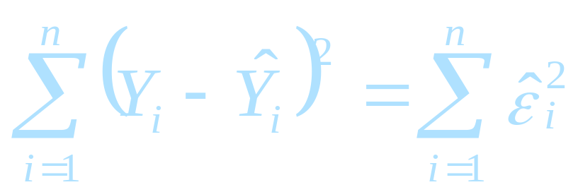
Least Squares
1. ‘Best Fit’ Means Difference Between Actual Y Values & Predicted Y Values Are a Minimum. But Positive Differences Off-Set Negative. So square errors!
2. LS Minimizes the Sum of the Squared Differences (errors) (SSE)
EPI 809/Spring 2008
Notes:
51

Slide 48
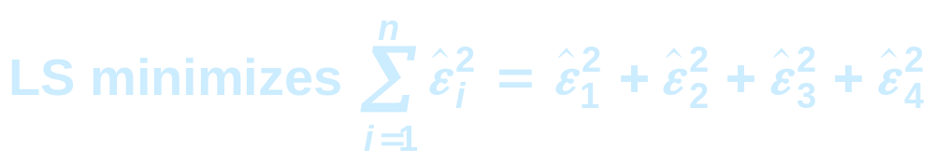

Least Squares Graphically
EPI 809/Spring 2008
Notes:
52

Slide 49
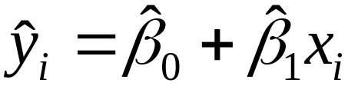
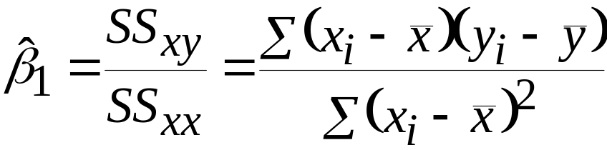
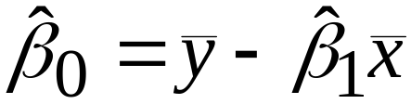
Coefficient Equations
Prediction equation
Sample slope
Sample Y - intercept
EPI 809/Spring 2008

Slide 50
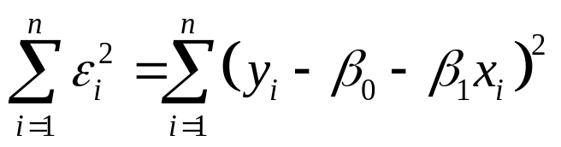
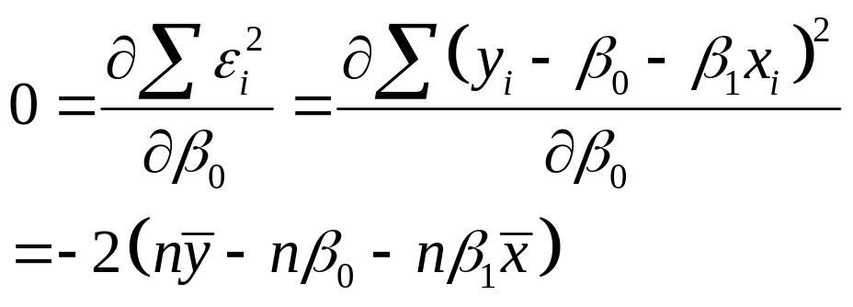
Derivation of Parameters (1)
Least Squares (L-S):
Minimize squared error
EPI 809/Spring 2008

Slide 51
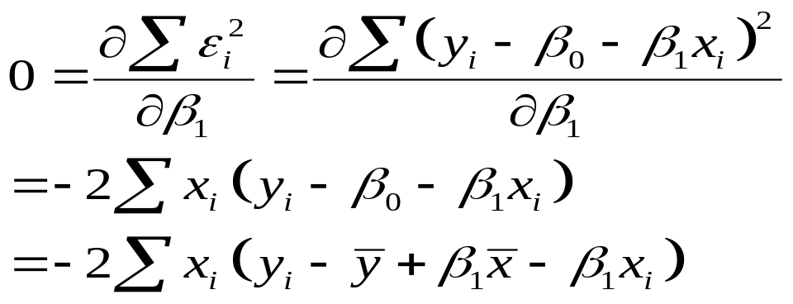
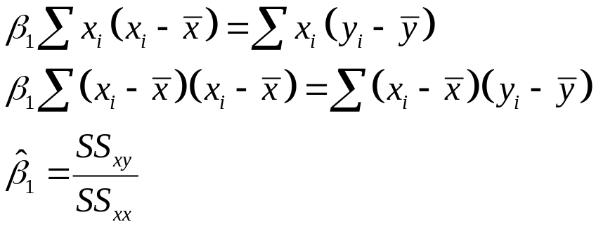
Derivation of Parameters (1)
Least Squares (L-S):
Minimize squared error
EPI 809/Spring 2008

Slide 52
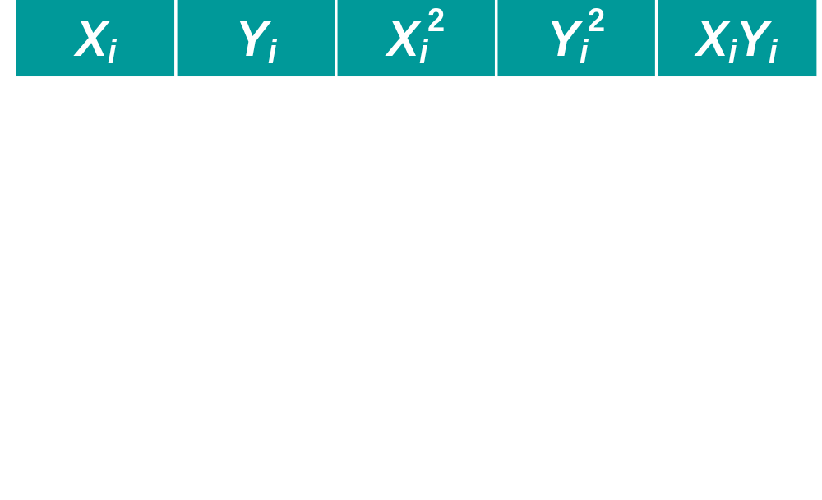
Computation Table
EPI 809/Spring 2008
Notes:
54

Slide 53
Interpretation of Coefficients
EPI 809/Spring 2008

Slide 54
Interpretation of Coefficients
^
1. Slope (β₁)
  Estimated Y Changes by β₁ for Each 1 Unit Increase in X
    If β₁ = 2, then Y Is Expected to Increase by 2 for Each 1 Unit Increase in X
^
^
EPI 809/Spring 2008

Slide 55
Interpretation of Coefficients
^
1. Slope (β₁)
  Estimated Y Changes by β₁ for Each 1 Unit Increase in X
    If β₁ = 2, then Y Is Expected to Increase by 2 for Each 1 Unit Increase in X
2. Y-Intercept (β₀)
  Average Value of Y When X = 0
    If β₀ = 4, then Average Y Is Expected to Be 4 When X Is 0
^
^
^
^
EPI 809/Spring 2008

Slide 56
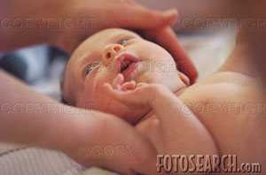
Parameter Estimation Example
Obstetrics: What is the relationship between
Mother’s Estriol level & Birthweight using the following data?
Estriol Birthweight
(mg/24h) (g/1000)
1 1
2 1
3 2
4 2
5 4
EPI 809/Spring 2008

Slide 57

Scatterplot
Birthweight vs. Estriol level
Birthweight
Estriol level
EPI 809/Spring 2008
Notes:
57

Slide 58
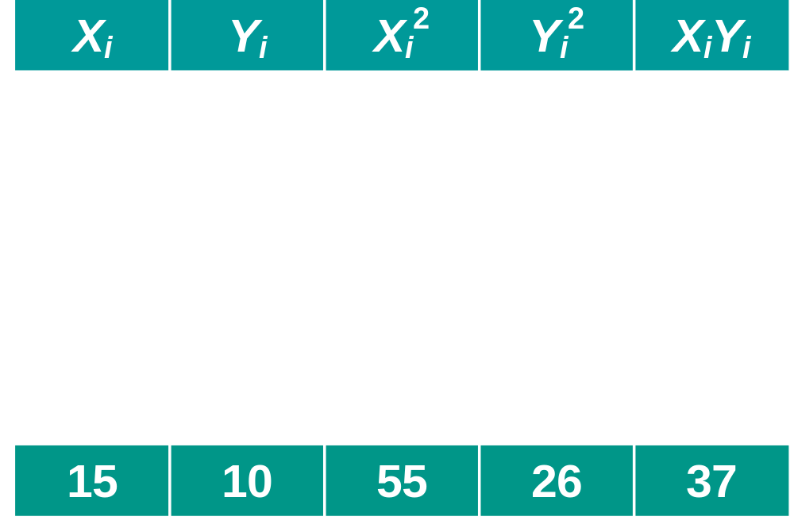
Parameter Estimation Solution Table
EPI 809/Spring 2008
Notes:
58

Slide 59
Parameter Estimation Solution
EPI 809/Spring 2008
Notes:
59

Slide 60
Coefficient Interpretation Solution
EPI 809/Spring 2008

Slide 61
Coefficient Interpretation Solution
^
1. Slope (β₁)
  Birthweight (Y) Is Expected to Increase by .7 Units for Each 1 unit Increase in Estriol (X)
EPI 809/Spring 2008

Slide 62
Coefficient Interpretation Solution
^
1. Slope (β₁)
  Birthweight (Y) Is Expected to Increase by .7 Units for Each 1 unit Increase in Estriol (X)
2. Intercept (β₀)
  Average Birthweight (Y) Is -.10 Units When Estriol level (X) Is 0
    Difficult to explain
    The birthweight should always be positive
^
EPI 809/Spring 2008

Slide 63
SAS codes for fitting a simple linear regression
Data BW; /*Reading data in SAS*/
input estriol birthw@@;
cards;
1 1 2 1 3 2
4 2 5 4
;
run;
PROC REG data=BW; /*Fitting linear regression models*/
model birthw=estriol;
run;
EPI 809/Spring 2008

Slide 64
Parameter Estimation
SAS Computer Output
Parameter Estimates
Parameter Standard
Variable DF Estimate Error t Value Pr > |t|
Intercept 1 -0.10000 0.63509 -0.16 0.8849
Estriol 1 0.70000 0.19149 3.66 0.0354
^
^
β₀
β₁
EPI 809/Spring 2008

Slide 65

Parameter Estimation Thinking Challenge
You’re a Vet epidemiologist for the county cooperative. You gather the following data:
Food (lb.) Milk yield (lb.)
4 3.0
6 5.5
10 6.5
12 9.0
What is the relationship
between cows’ food intake and milk yield?
© 1984-1994 T/Maker Co.
EPI 809/Spring 2008
Notes:
62

Slide 66

Scattergram
Milk Yield vs. Food intake*
M. Yield (lb.)
Food intake (lb.)
EPI 809/Spring 2008
Notes:
65

Slide 67
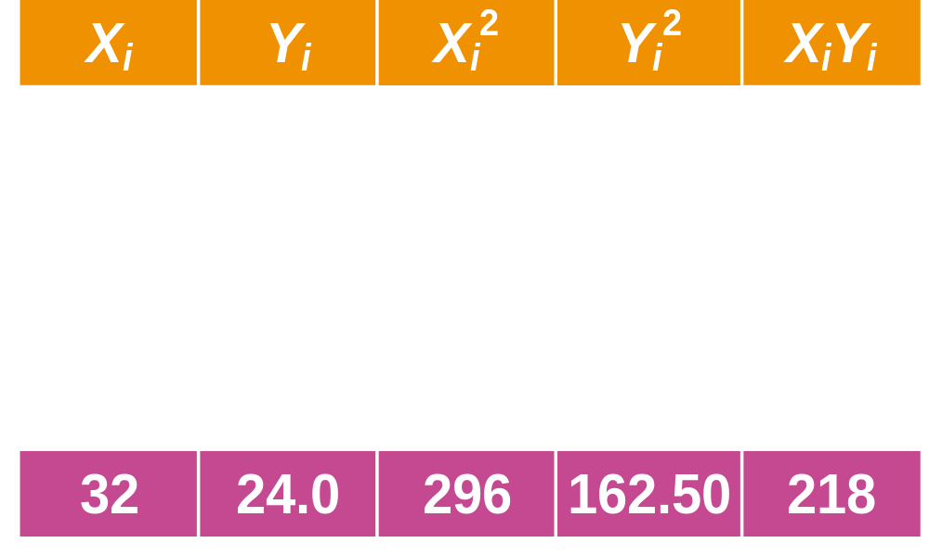
Parameter Estimation Solution Table*
EPI 809/Spring 2008
Notes:
66

Slide 68
Parameter Estimation Solution*
EPI 809/Spring 2008
Notes:
67

Slide 69
Coefficient Interpretation Solution*
EPI 809/Spring 2008

Slide 70
Coefficient Interpretation Solution*
^
1. Slope (β₁)
  Milk Yield (Y) Is Expected to Increase by .65 lb. for Each 1 lb. Increase in Food intake (X)
EPI 809/Spring 2008

Slide 71
Coefficient Interpretation Solution*
^
1. Slope (β₁)
  Milk Yield (Y) Is Expected to Increase by .65 lb. for Each 1 lb. Increase in Food intake (X)
2. Y-Intercept (β₀)
  Average Milk yield (Y) Is Expected to Be 0.8 lb. When Food intake (X) Is 0
^
EPI 809/Spring 2008

